Slide 1
Graffiti (Street Art)

Slide 2
Quick History
The act of graffiti began when humans first started to create images on walls. The modern era began ‘60’s by political advocates to make statements and gangs to mark territory.
Sources vary, but many believe to have started in Philadelphia or New York City. (Cornbread and Cool Earl=Phili / Taki 183=NY)
Paint was the primary medium, then began to evolve through the years.

Slide 3
Common Terms
Bombing: the act of creating graffiti. Usually many tags or throws in one area.
Tag: a quick design. Usually a name or initials.
Throw: A design with more thought. May have more than one color and depth.
Piece: Short for masterpiece. Takes up larger areas and takes more time. May incorporate 3-D and more complex effects.

Slide 4
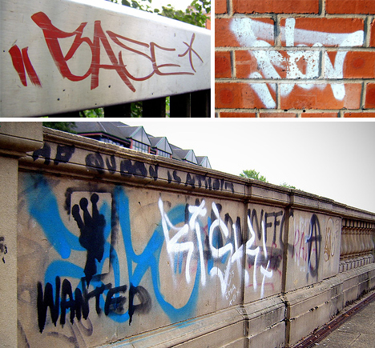
Tags

Slide 5
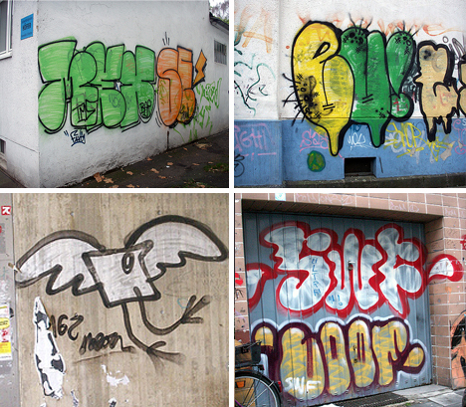
Throw

Slide 6
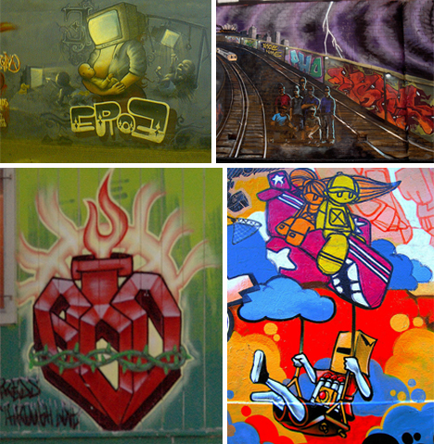
Pieces

Slide 7
Types of Graffiti
Posters
Adbusting
Spray Paint Stencils
Screen Printing
Stickers
Freehand
Installations

